Slide 1



Basics of Algorithmization and Program
Prepared & Presented by: Mirlan Nurbekov, Lecturer
Office hours: Friday 8:00–17:00
AlaToo IT & Business College
Fall 2025

Slide 2
Heap sort
A heap is a special type of binary tree used mainly for fast selection of the largest or smallest value.
It is a complete binary tree (every level is fully filled from left to right, except possibly the last)
Each parent node must follow a strict ordering rule:
Max-Heap: parent value is greater than or equal to its children
Min-Heap: parent value is less than or equal to its children
Because of this property, the most important element in the structure is always located at the root.

Slide 3
Heap sort
Heaps are widely used in:
scheduling systems,
priority queues,
memory management,
algorithms like Dijkstra and Prim.

Slide 4
Heap sort
Heap Sort is a sorting algorithm that uses the heap structure to arrange elements in ascending or descending order.
1. Convert the array into a max-heap, so the largest element is always at the root
2. Swap the root with the last element. The largest value moves to its correct final position)
3. Reduce the heap size
4. Re-build the heap (heapify)
5. Repeat until all elements are sorted
Because we always take the largest element and place it at the end, the array gradually becomes sorted.

Slide 5
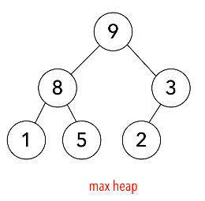
Heap sort
heap: ordered binary tree
max heap: parent > child

Slide 6
Heap sort
To run heap sort we gonna use few functions:
build-max-heap: creates max heap from unsorted array
heapify: similar to build-max-heap, but assumes part of array is already sorted

Slide 7
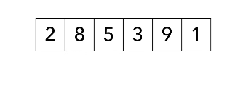
Heap sort
Create max heap
Remove largest item
Place item in sorted partition

Slide 8
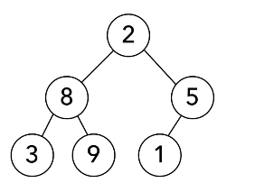
Heap sort

Slide 9
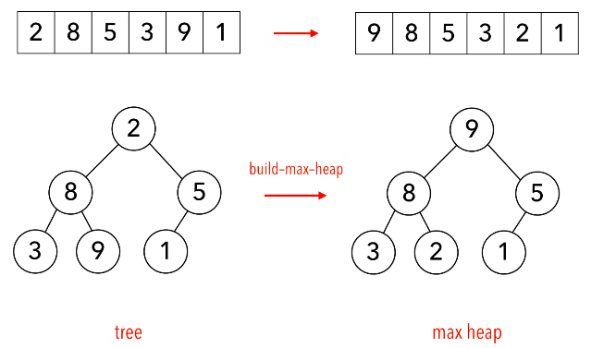
Heap sort

Slide 10
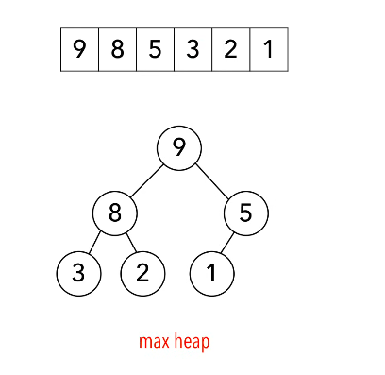
Heap sort

Slide 11
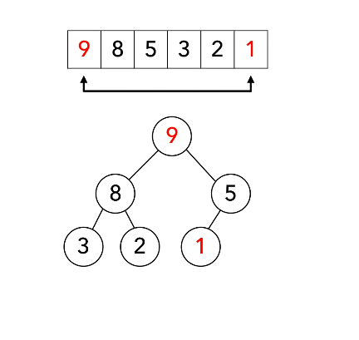
Heap sort

Slide 12
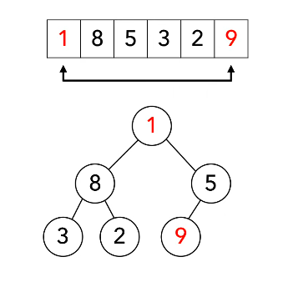
Heap sort

Slide 13
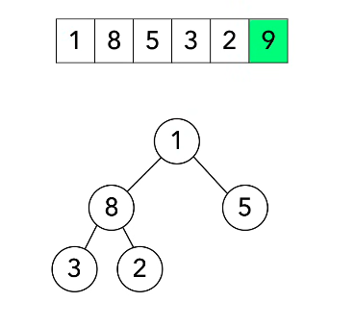
Heap sort

Slide 14
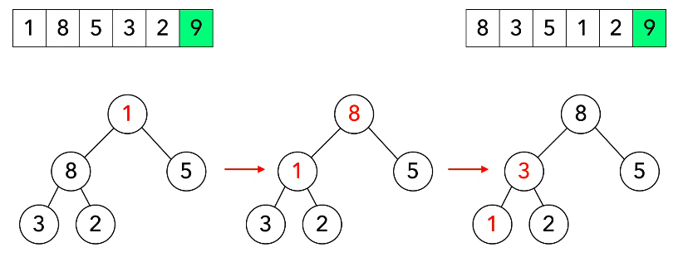
Heap sort (heapify)

Slide 15
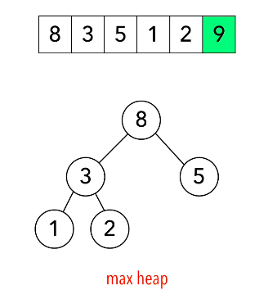
Heap sort

Slide 16
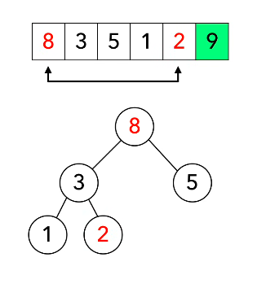
Heap sort

Slide 17
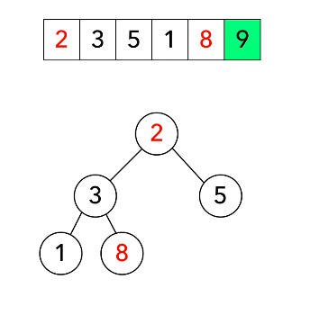
Heap sort

Slide 18
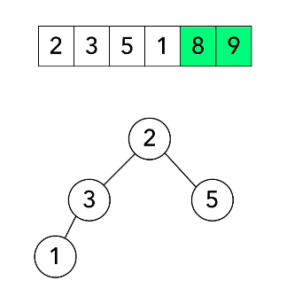
Heap sort

Slide 19
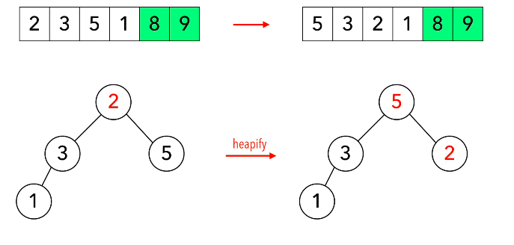
Heap sort (heapify)

Slide 20
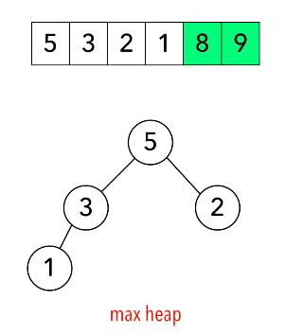
Heap sort

Slide 21
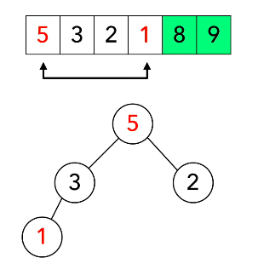
Heap sort

Slide 22
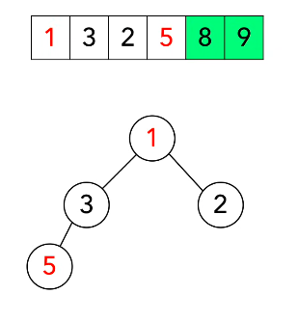
Heap sort

Slide 23
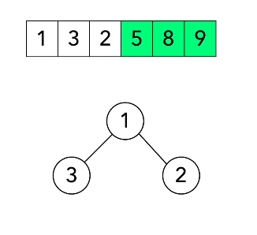
Heap sort

Slide 24
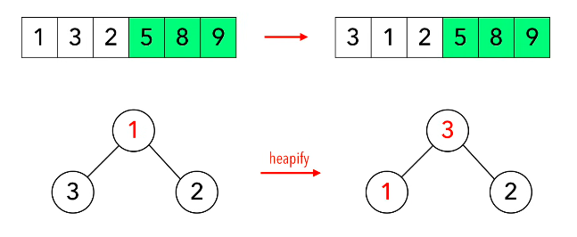
Heap sort(heapify)

Slide 25
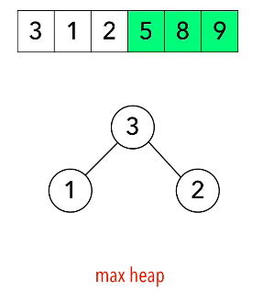
Heap sort

Slide 26
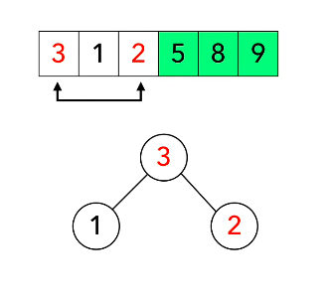
Heap sort

Slide 27
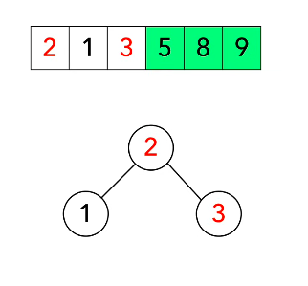
Heap sort

Slide 28
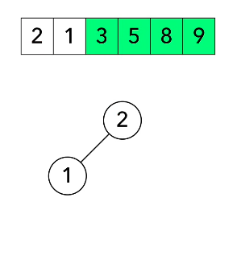
Heap sort

Slide 29
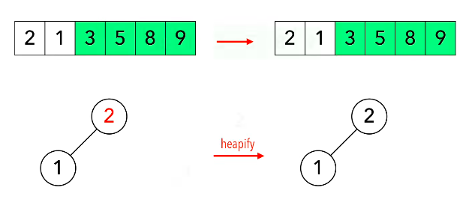
Heap sort(heapify)

Slide 30
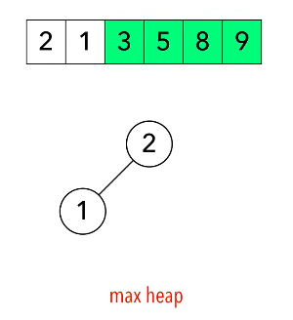
Heap sort

Slide 31
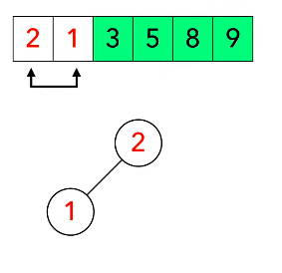
Heap sort

Slide 32
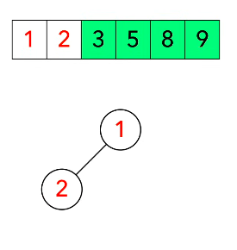
Heap sort

Slide 33
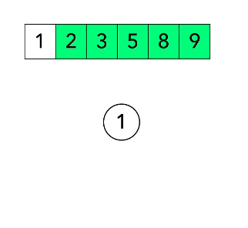
Heap sort

Slide 34
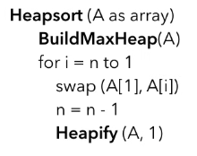
Heap sort

Slide 35
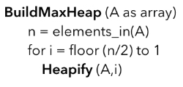
Heap sort

Slide 36
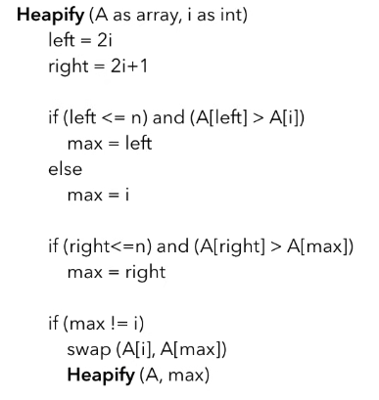
Heap sort

